Slide 1
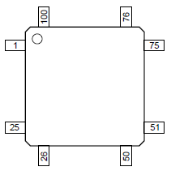
INPUT/OUTPUT (IO) PROGRAMMING
LPC1768 pin configuration
512 K Flash memory
64K SRAM
8K ROM
100 pin IC

Slide 2
What is IO programming?
Through IO programming microcontroller can be used to control other devices such as sensors, displays, On-chip modules etc.
It is done through GPIO (General purpose Input Output).
GPIO is a pin on an IC (Integrated Circuit). It can be either input pin or output pin, whose behavior can be controlled at the run time. It's a standard interface used to connect microcontrollers to other electronic devices.
In LPC1768, there are 5 ports, P0 to P4 each 32 bit (i.e., 32 pins). Few port pins are not available. (total pins = 100)
In GPIO operation we perform general purpose operation to read from the port and to write to the port.

Slide 3
GPIO in LPC1768
5 general purpose bidirectional digital IO ports, Port 0, Port 1, Port 2, Port 3 and Port 4.
Fast GPIO-enhanced /Accelerated Features
Additionally Port 0 and Port 2 pins can provide a single interrupt
Application
General purpose I/O, Driving LEDs or other indicators, Controlling off-chip devices, Sensing digital inputs, detecting edges

Slide 4
Port 0
Pins 12, 13, 14 & 31 are not available.
Port 1
Pins 2, 3, 7, 6, 5, 11, 12, & 13 are not available.
Port 2
only pins 0 to 13 are available and rest are reserved.
Port 3
only pins 25,26 are available and rest are reserved.
Port 4
only 28,29 are available and rest are reserved.
In total 70 GPIO pins are available for the user.

Slide 5
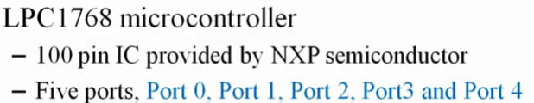
Pin connect block
The naming convention for port pins is ‘Px.y’ where ‘x’ is the port number and ‘y’ is simply the pin number in port ‘x’. For example : P0.7 refers to Pin number 7 of Port 0 , P2.11 refers to Pin number 11 in Port 2.

Slide 6

Pin Connect Block Registers
Pin function select registers

Slide 7
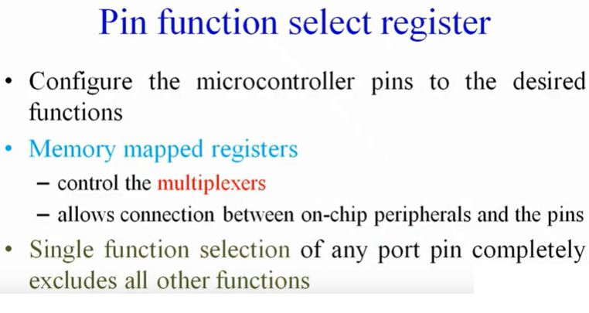

Slide 8
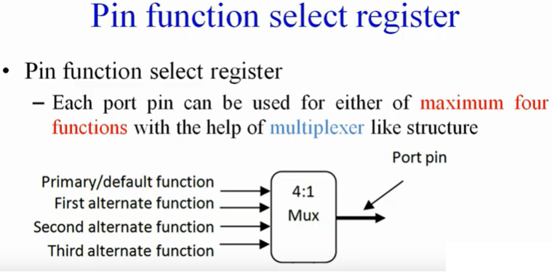

Slide 9
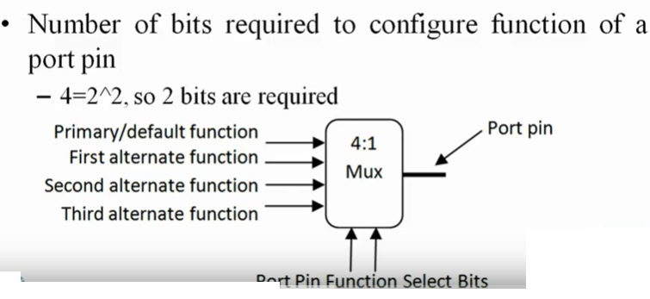

Slide 10
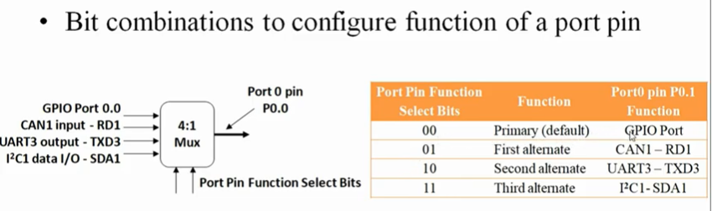

Slide 11
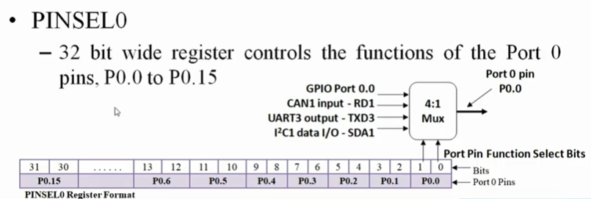

Slide 12
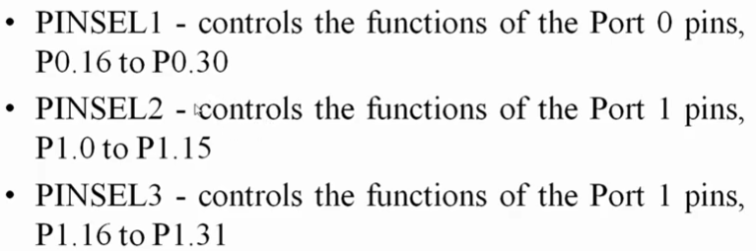

Slide 13
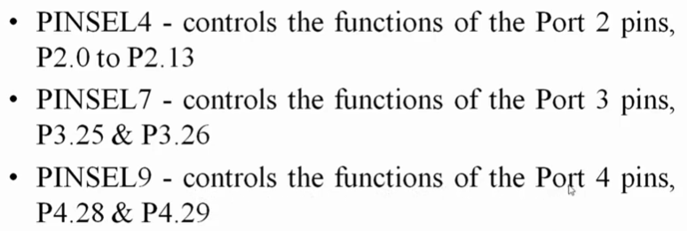

Slide 14


Slide 15
GPIO Registers
The ports are controlled by 5 registers (byte, halfword and word accessible)
These registers are present on Peripheral AHB bus(Advanced High performance Bus) for fast read/write timing.
Hence the naming convention uses a prefix of “FIO” for all the registers related to GPIO.

Slide 17
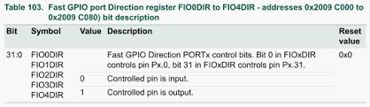

Slide 18
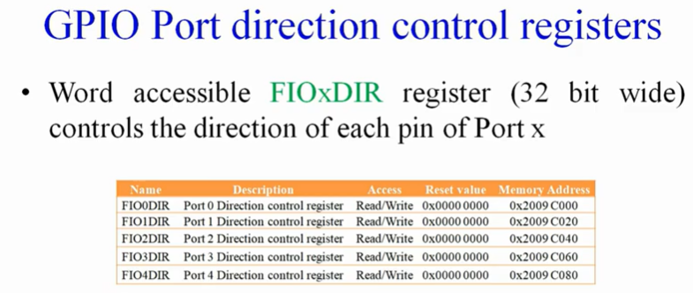

Slide 19
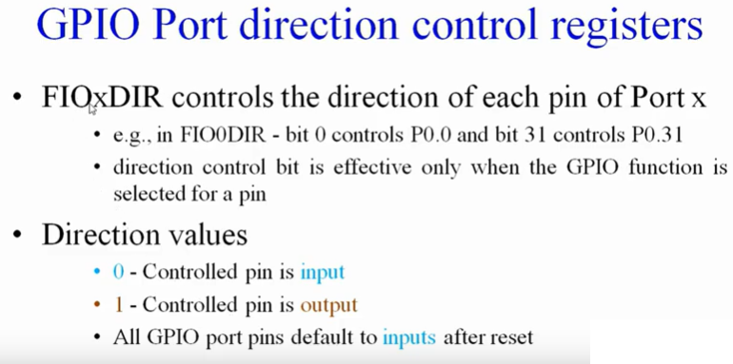

Slide 20
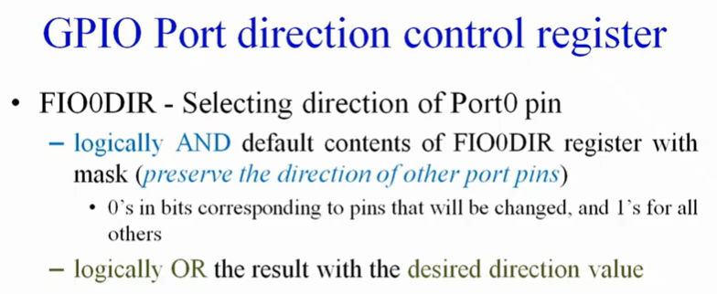

Slide 21
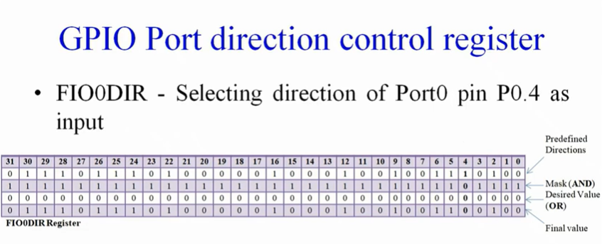

Slide 22
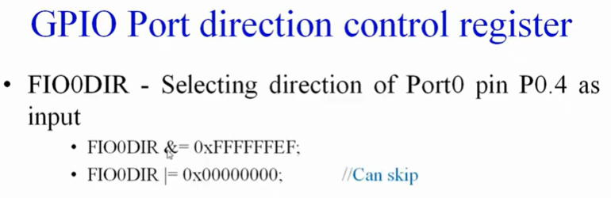

Slide 23
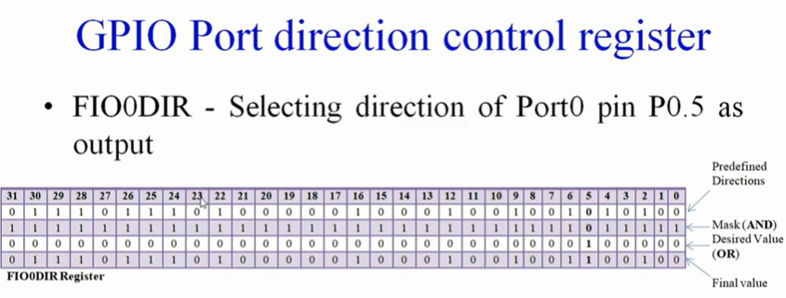

Slide 24
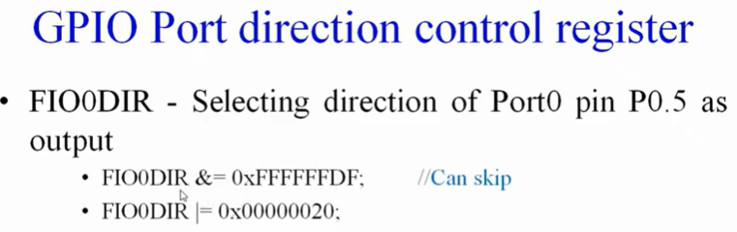
Ref:
https://www.youtube.com/watch?v=5ipqQsguqdE -- FIOxDIR
https://www.youtube.com/watch?v=WmZFfokztXg Pin Connect block
Chapter 8 and 9 in the user manual https://www.nxp.com/docs/en/user-guide/UM10360.pdf

Slide 25
GPIO port output Set register FIOxSET (FIO0SET to FIO4SET)
This register is used to produce a HIGH level output at the port pins configured as GPIO in an OUTPUT mode.
Writing 1 produces a HIGH level at the corresponding port pins.
Writing 0 has no effect.
If any pin is configured as an input or a secondary function, writing 1 to the corresponding bit in the FIOxSET has no effect.
Reading the FIOxSET register returns the value of this register, as determined by previous writes to FIOxSET and FIOxCLR (or FIOxPIN).
Access to a port pin via the FIOxSET register is conditioned by the corresponding bit of the FIOxMASK register

Slide 27
GPIO port output Clear register FIOxCLR (FIO0CLR to FIO4CLR)
This register is used to produce a LOW level output at port pins configured as GPIO in an OUTPUT mode.
Writing 1 produces a LOW level at the corresponding port pin and clears the corresponding bit in the FIOxSET register.
Writing 0 has no effect. If any pin is configured as an input or a secondary function, writing to FIOxCLR has no effect.
Access to a port pin via the FIOxCLR register is conditioned by the corresponding bit of the FIOxMASK register

Slide 29
GPIO port Pin value register FIOxPIN (FIO0PIN to FIO4PIN)
This register provides the value of port pins that are configured to perform only digital functions.
The register will give the logic value of the pin regardless of whether the pin is configured for input or output, or as GPIO or an alternate digital function.
Any configuration of that pin will allow its current logic state to be read from the corresponding FIOxPIN register.
Writing to the FIOxPIN register stores the value in the port output register. This feature should be used carefully in an application since it affects the entire port.
Access to a port pin via the FIOxPIN register is conditioned by the corresponding bit of the FIOxMASK register
Only pins masked with zeros in the Mask register will be correlated to the current content of the Fast GPIO port pin value register.

Slide 30
Fast GPIO port Mask register FIOxMASK (FIO0MASK to FIO4MASK)
This register is used to select port pins that will and will not be affected by write accesses to the FIOxPIN, FIOxSET or FIOxCLR register. Mask register also filters out port’s content when the FIOxPIN register is read.
A zero in this register’s bit enables an access to the corresponding physical pin via a read or write access. If a bit in this register is one, corresponding pin will not be changed with write access and if read, will not be reflected in the updated FIOxPIN register.

